Slide 1
PSCS-195 - Talking Fingers
PIP2001 Capstone Project
Final Review
Batch Nuber: CSE-65
STUDENT NAME | ROLL NUMBER
20211CSE0640 | ANUSHA MALIPATIL
20211CSE0646 | SNEHA S BALLARI
20211CSE0675 | THAKSHA PRABHAKAR
20211CSE0676 | SNEHA A
Under the Supervision of,
Dr./Mr./Ms./ProfUnder the Supervision of,
Mr.Ramesh T
Assistant Professor
School of Computer Science and Engineering
Presidency University
.
Name of the Program: CSE
Name of the HoD: Dr.Asif Mohammed H.B
Name of the Program Project Coordinator: Mr. Amarnath J.L & Dr. Jayanthi. K.
Name of the School Project Coordinators: Dr. Sampath A K / Dr. Abdul Khadar A / Mr. Md Ziaur Rahman

Slide 2
Introduction
- Overview of Talking Fingers project
- Objective: Real-time translation of multilingual speech to Indian Sign Language (ISL)
- Promotes inclusivity and accessibility for the deaf community

Slide 3
Significance of the Project
- Addresses communication barriers faced by the deaf community
- Supports multiple Indian languages (Hindi, Kannada, Tamil, Telugu, English)
- Utilizes advanced technologies like NLP, speech recognition, and 3D animations

Slide 4
Challenges Faced
- Communication barriers due to lack of interpreters
- Limited access to education and employment
- Technological limitations for ISL adoption
- Social isolation

Slide 5
Proposed Solution
- Multilingual speech-to-ISL translation system
- Real-time transcription and ISL animation
- Scalable and cost-effective architecture
- Promotes inclusivity and accessibility

Slide 6
Methodology
1. Input Processing: Speech-to-text using Web Speech API
2. Translation: Multilingual transcription using Google Translate API
3. Text Processing: NLP techniques for tokenization, lemmatization
4. ISL Animation Mapping: High-quality animations using Blender 3D

Slide 7
System Workflow
- User inputs speech or text
- Speech-to-text conversion
- Translation into English
- Text preprocessing and mapping to ISL animations
- Display animations on the web interface

Slide 8
Tools and Technologies
- Backend: Django, Web Speech API
- Frontend: HTML, CSS, JavaScript
- NLP: NLTK
- Translation: googletrans Python library
- Animation: Blender 3D

Slide 9
Outcomes
- Real-time ISL translation for multilingual inputs
- Increased accessibility for the deaf community
- Supports communication in public spaces and education
- User-friendly and scalable system design

Slide 10
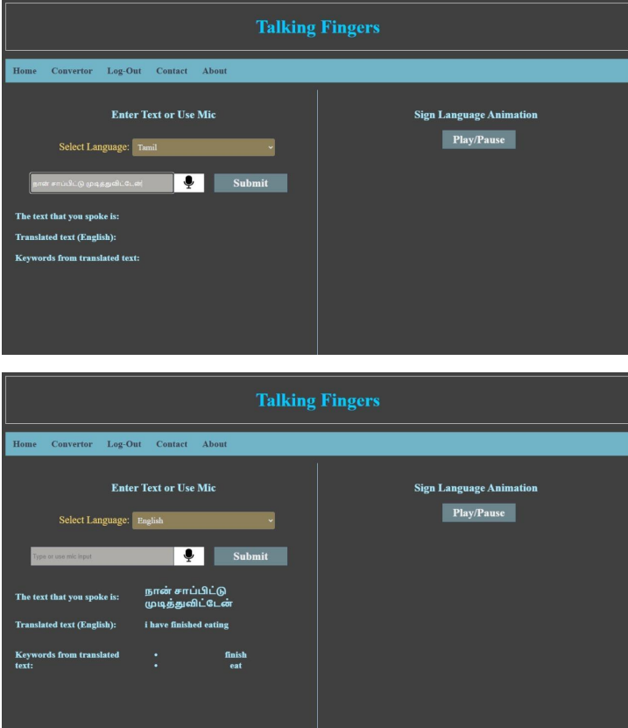

Slide 11
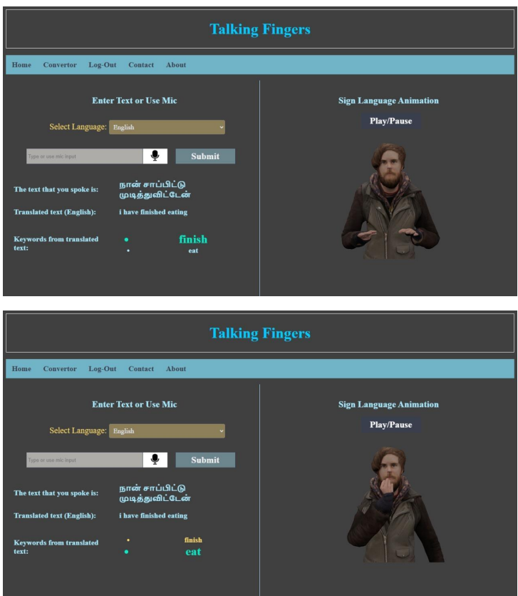

Slide 12
Github Link
Talking-Fingers
https://github.com/snehaballari/Talking-Fingers.git

Slide 13
Conclusion
- 'Talking Fingers' bridges communication gaps
- Promotes inclusivity and accessibility
- Future scope: Expand ISL vocabulary, enhance real-time capabilities, and improve animation quality

Slide 14


